Slide 1
CASE STUDY of
Motion picture Data Analysis using SQL
Bhagyashree More
SQL: The Language of Data where every Table has a story to tell.

Slide 2
Sakila DataBase
Sakila is a movie rental store with a vast collection of movies in DVDs and blue ray disc formats.
This Motion Picture Data Analysis is performed on Sakila DataBase.
Based on data different task analysis need to done to obtain the desired output.
As per the tables and data in Sakila Database few such Analysis were done

Slide 3
Content
Task 1: Display first name, last name, actor_id, last_update form actor table.
Task 2: Display full name of all actor, first name and last name along with the count of first name and last name.
Task 3: Display the count of movies grouped by rating.
Task 4: Display average rental rates based on the movie rating.
Task 5: Display the movie titles where the replacement cost is up to $9.
Task 6: List all the movies along with the number of actors listed for each movie.
Task 7: Display the movie title starting with the letters 'K' and 'Q’.
Task 8: Display first name, last name of all actor who are a part of ‘Agent Truman' movie.
Task 9: Identify and display the names of the movies in the family category.
Task 10: Display the names of the most frequently rented movies in descending order, so that the management can maintain more copies of such movies.
Task 11: Calculate and display the number of movie categories where the average between the movie replacement cost and the rental rate is greater than $15.
Task 12: display the names of these categories/genres and the number of movies per category/genre sort by the number of movies

Slide 4
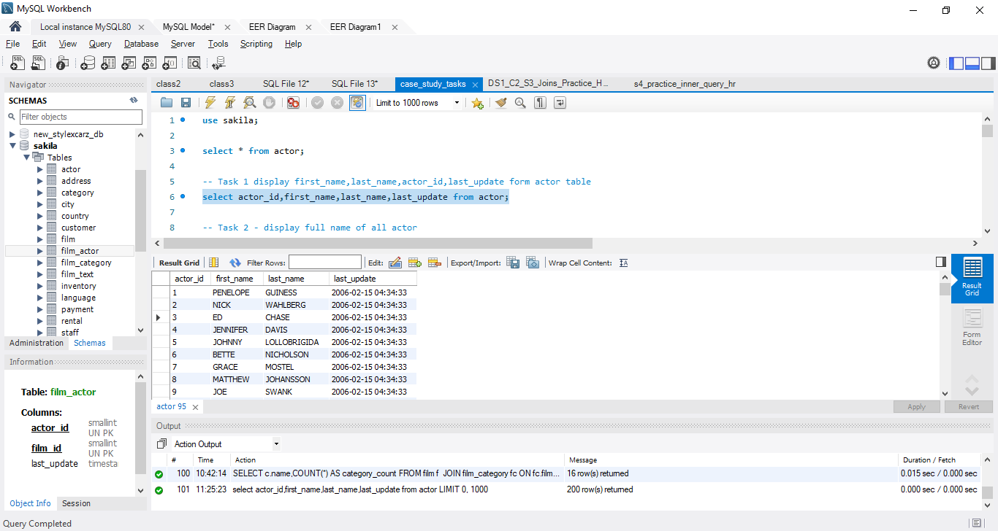
Task 1: Display first name, last name, actor_id, last_update form actor table.
QUERY
select actor_id,first_name,last_name,last_update from actor;
Result
Using the Sakila Database and by selecting few parameters of the Actor table the Names were displayed with their last update in their movie Collection.
Conclusion:

Slide 5
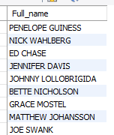
Task 2: a. display full name of all actor.
QUERY
select concat(first_name,' ',last_name) as Full_name from actor;
Result
Conclusion:
Using the Sakila Database and by select query display fullname using concat()

Slide 6
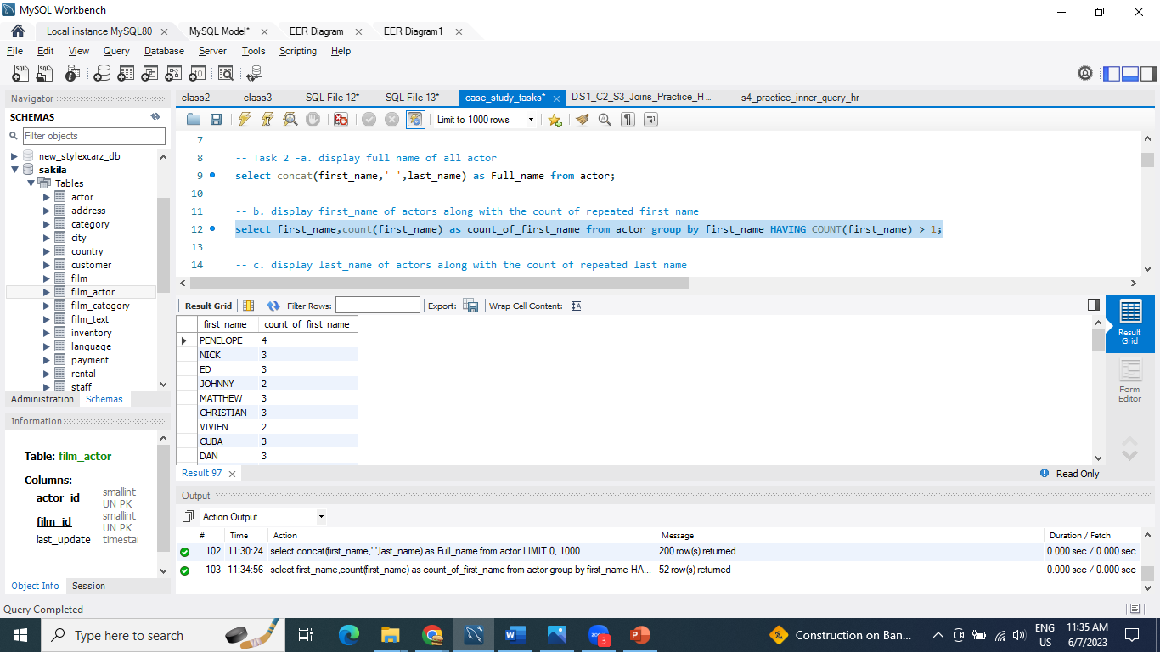
Task 2: b. display first name of actors along with the count of repeated first name
QUERY
select first_name,count(first_name) as count_of_first_name from actor group by first_name HAVING COUNT(first_name) > 1;
Result
Conclusion:
Using the Sakila Database display firstname and count of repeated firstname.

Slide 7
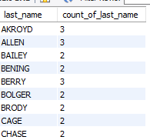
Task 2: c. Display last_name of actors along with the count of repeated last name
QUERY
select last_name, count(last_name) as count_of_last_name from actor group by last_name HAVING COUNT(last_name) > 1;
Result
Conclusion:
Using the Sakila Database display lastname and count of repeated lastname.

Slide 8
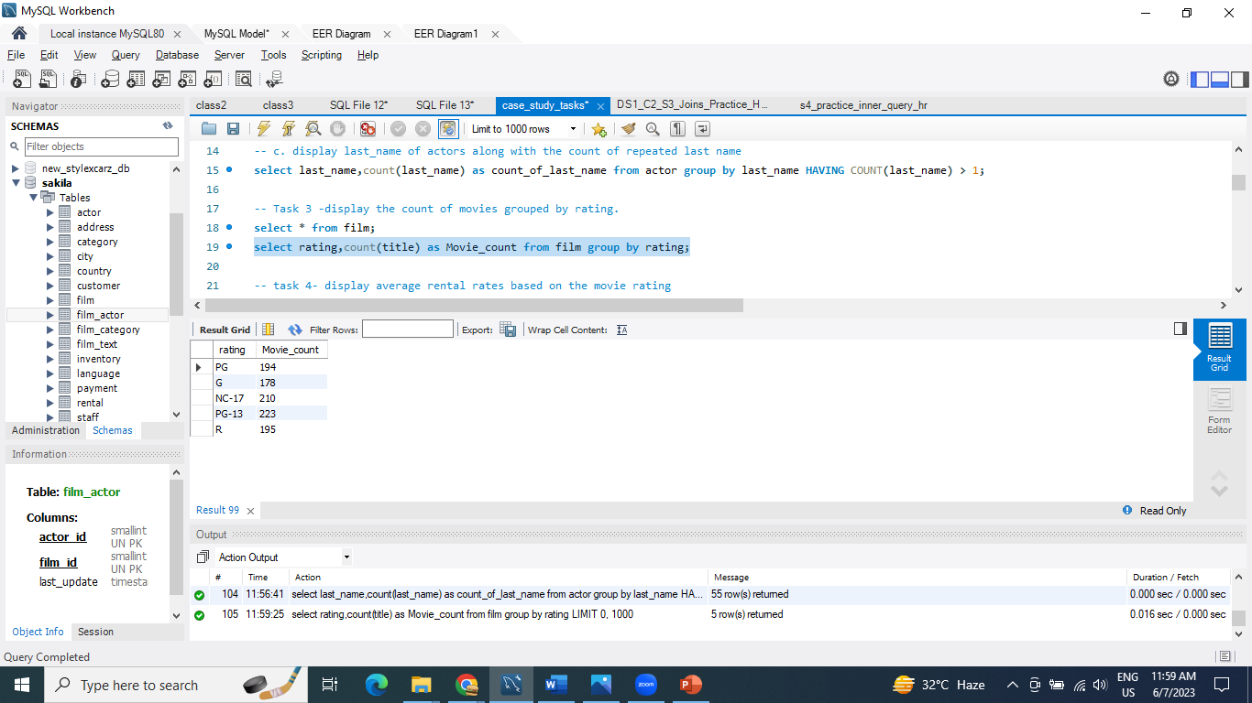
Task 3: Display the count of movies grouped by rating
QUERY
select rating,count(title) as Movie_count from film group by rating;
Result
Using the Sakila Database display rating and Movie count group by rating.
Conclusion:

Slide 9
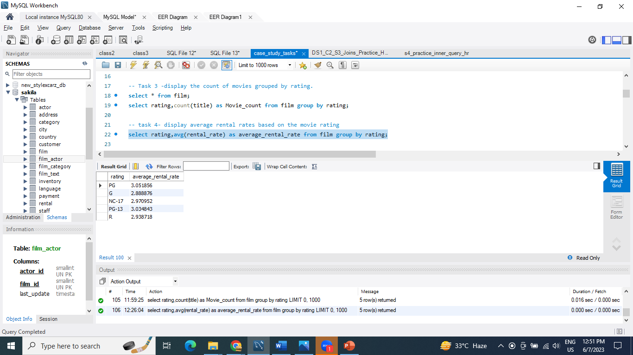
Task 4: Display average rental rates based on the movie rating
QUERY
select rating,avg(rental_rate) as average_rental_rate from film group by rating;
Result
Using the Sakila Database display rating and average_rantal_rate based on the movie rating.
Conclusion:

Slide 10
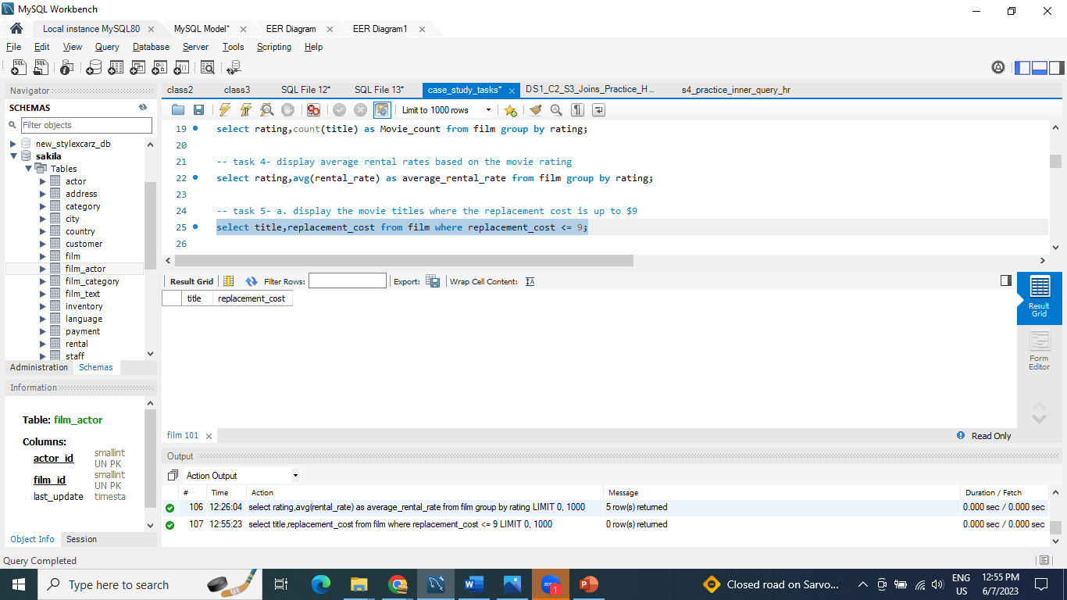
Task 5: a. display the movie titles where the replacement cost is up to $9
QUERY
select title,replacement_cost from film where replacement_cost <= 9;
Result
Using the Sakila Database no movie found where replacement cost is up to $9.
Conclusion:

Slide 11
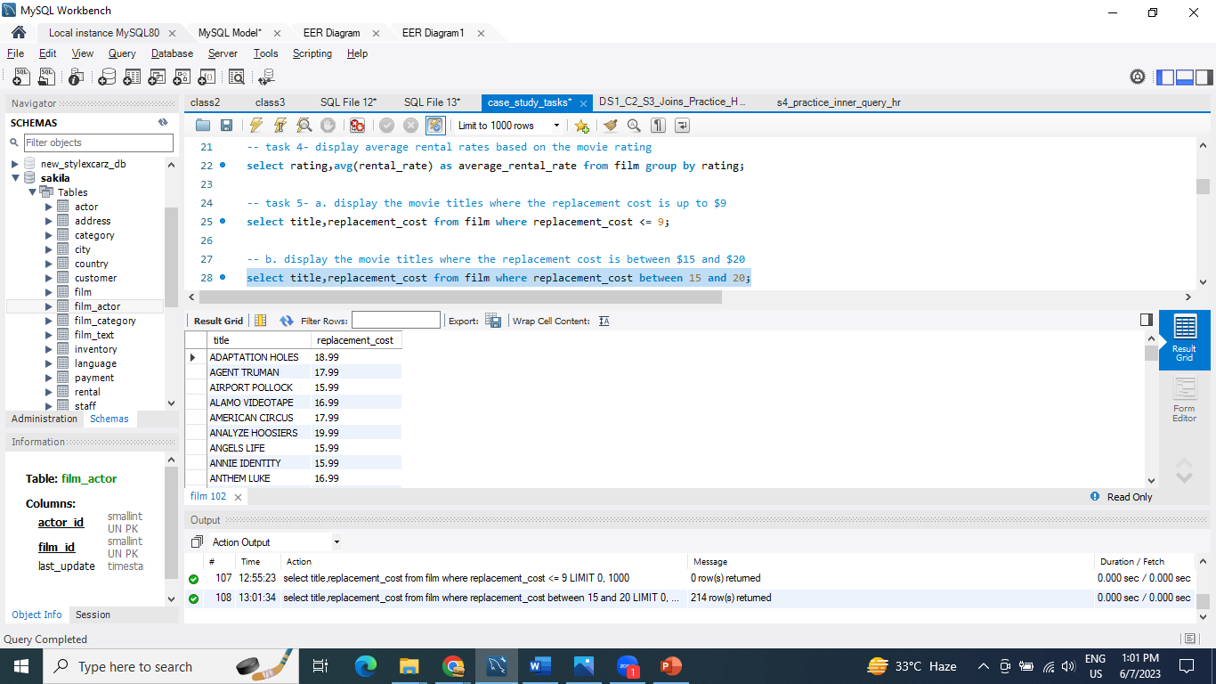
Task 5: b. Display the movie titles where the replacement cost is between $15 and $20
QUERY
select title,replacement_cost from film where replacement_cost between 15 and 20;
Result
Conclusion:
Using the Sakila Database display movie name and replacement cost between 15 & 20

Slide 12
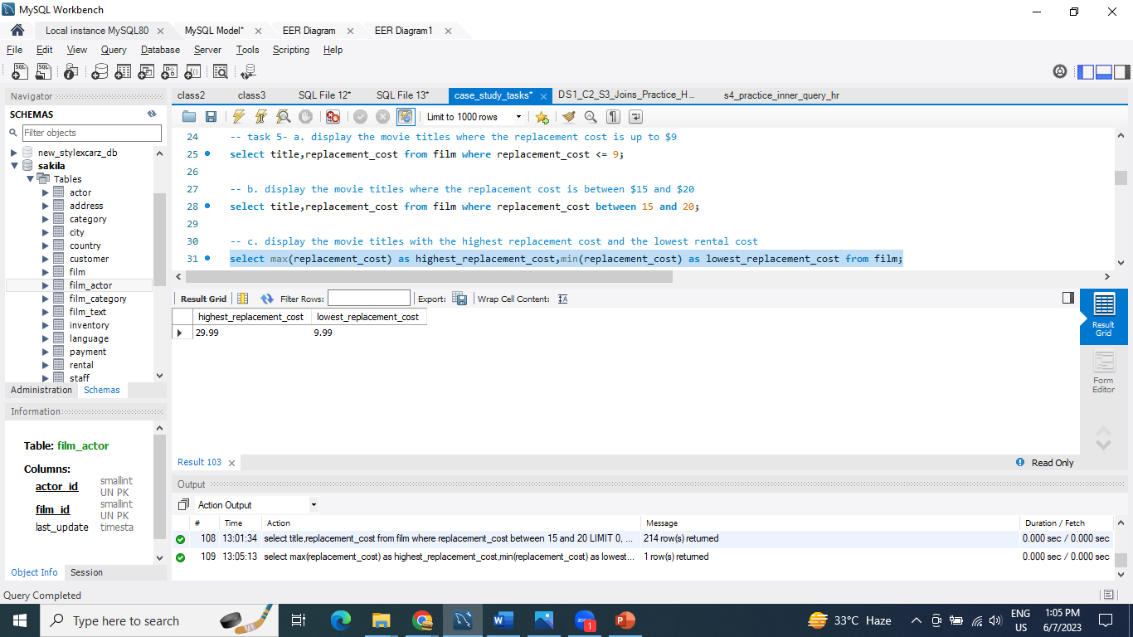
Task 5: c. display the movie titles with the highest replacement cost and the lowest rental cost
QUERY
select max(replacement_cost) as highest_replacement_cost,min(replacement_cost) as lowest_replacement_cost from film;
Result
Using the Sakila Database highest replacement cost is 29.99 and lowest replacement cost is 9.99
Conclusion:

Slide 13
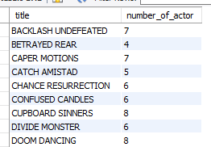
Task 6: list all the movies along with the number of actors listed for each movie
QUERY
select f.title,count(fa.actor_id) as number_of_actor from film f join film_actor fa on f.film_id=fa.film_id join actor a on fa.actor_id=a.actor_id group by f.title;
Result
Using the Sakila Database backlash undefeated have 7 number of actors
Conclusion:

Slide 14
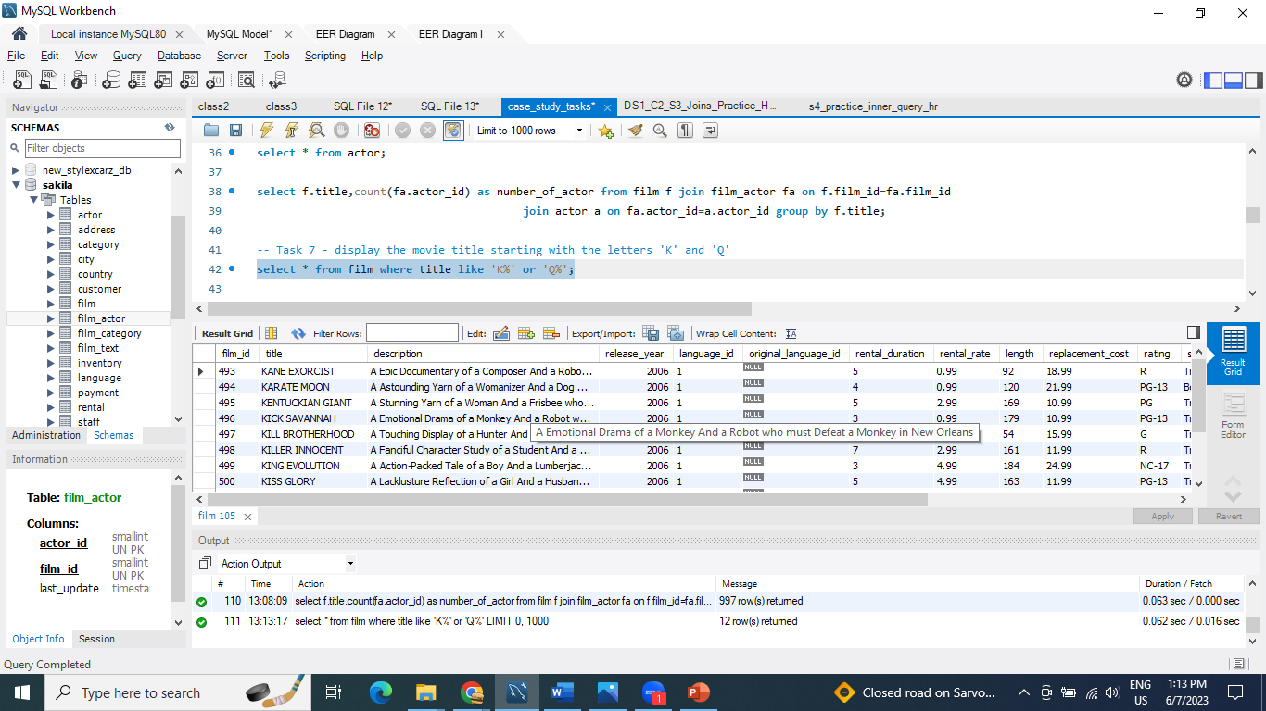
Task 7: Display the movie title starting with the letters 'K' and 'Q'
QUERY
select * from film where title like 'K%' or 'Q%';
Result
Using the Sakila Database all the data display where movie title starting with letters ‘K’ and ‘Q’
Conclusion:

Slide 15
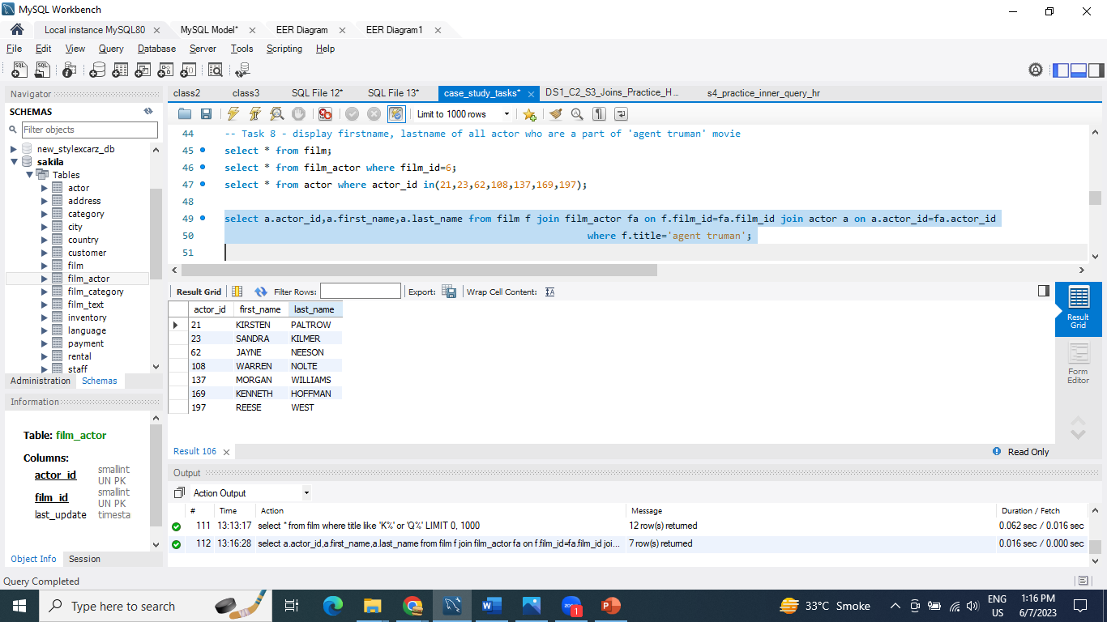
Task 8: Display first name, last name of all actor who are a part of 'agent truman' movie
QUERY
select a.actor_id,a.first_name,a.last_name from film f join film_actor fa on f.film_id=fa.film_id join actor a on a.actor_id=fa.actor_id where f.title='agent truman';
Result
Conclusion:
Using the Sakila Database 7 actors work in ‘Agent Truman’ movie.

Slide 16
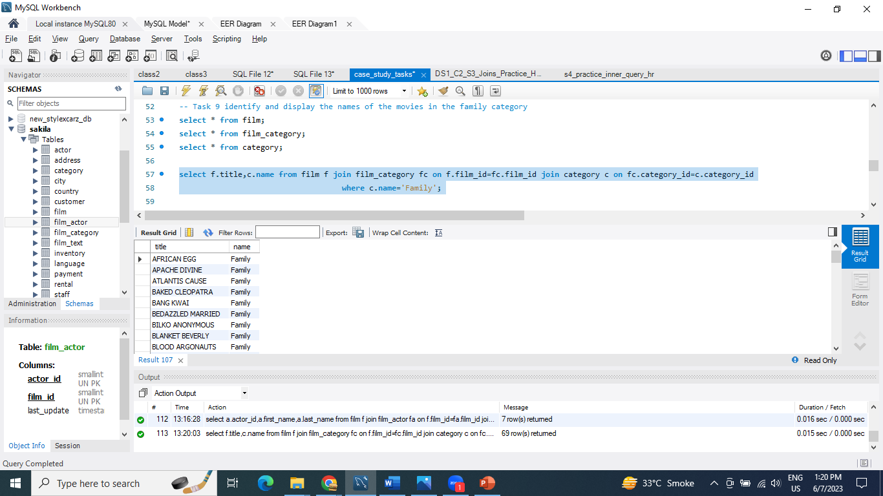
Task 9: Identify and display the names of the movies in the family category
QUERY
select f.title,c.name from film f join film_category fc on f.film_id=fc.film_id join category c on fc.category_id=c.category_id where c.name='Family';
Result
Conclusion:
Using the Sakila Database display the name of movie in family category.

Slide 17
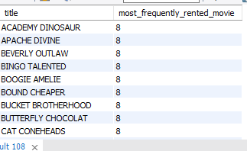
Task 10: Display the names of the most frequently rented movies in descending order, so that the management can maintain more copies of such movies.
QUERY
select f.title,count(i.inventory_id) as most_frequently_rented_movie from film f join inventory i on f.film_id=i.film_id group by f.title order by most_frequently_rented_movie desc;
Result
Conclusion:
Using the Sakila Database display most frequently rented movie.

Slide 18
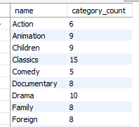
Task 11: calculate and display the number of movie categories where the average between the movie replacement cost and the rental rate is greater than $15
QUERY
SELECT c.name,COUNT(*) AS category_count FROM film f JOIN film_category fc ON fc.film_id = f.film_id JOIN category c ON c.category_id = fc.category_id WHERE (f.replacement_cost + f.rental_rate) / 2 > 15 group by c.name;
Result
Conclusion:
Using the Sakila Database display the number of movie categories where the average between the movie replacement cost and rental rate is greater than $15.

Slide 19
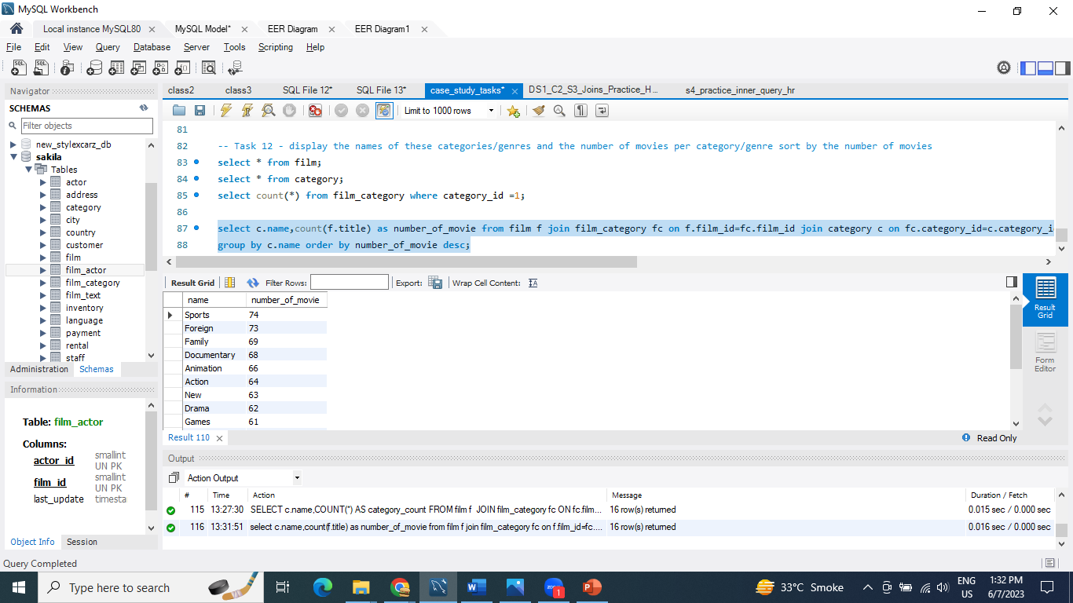
Task 12: display the names of these categories/genres and the number of movies per category/genre sort by the number of movies.
QUERY
select c.name,count(f.title) as number_of_movie from film f join film_category fc on f.film_id=fc.film_id join category c on fc.category_id=c.category_id group by c.name order by number_of_movie desc;
Result
Conclusion:
Using the Sakila Database sport category have more number of movie.

Slide 20
Summary:
In the tasks, we have used the sakila database and performed various operations like Average, count and joining tables to get the desired output by grouping then and arranging them in sequential order.
Also we used clauses like where clause, order by, group by clause to filter particular data from table.

Slide 21
THANK YOU

